Slide 1
SEVENT
The Saudi event marketplace
Weekly Progress Report
Where we are at the halfway mark
3 of 6 sprints delivered
~50% of the pilot system built
Supplier side end-to-end · Organizer RFQ flow live
PREPARED 2026-04-16
Pilot target — July 2026

Slide 2
WHAT SEVENT IS
One request. One platform. Full audit trail.
Sevent replaces the old "tender" pattern in the Saudi event industry. An organizer sends one request; the platform routes it to the best 3–5 verified suppliers and tracks every step from request through contract. Payments stay off-platform in the pilot — the system records state and generates a legally-consistent contract.
Organizer
Supplier
Admin
Public visitor
Posts events, sends RFQs, compares quotes, accepts one, reviews the supplier afterwards.
Gets verified, publishes catalog + pricing, receives RFQs, sends quotes, confirms bookings.
Verifies suppliers, resolves disputes, has read-only oversight of the entire system.
Browses approved suppliers by category and city — no login required.

Slide 3
PROGRESS AT A GLANCE
Halfway through a 12-week plan
25
16
Pilot suppliers seeded (Riyadh + Jeddah)
Automated checks passing
SPRINT 1
SPRINT 2
SPRINT 3
SPRINT 4
SPRINT 5
SPRINT 6
Foundations & schema
Supplier onboarding
RFQ & auto-match
Pricing & acceptance
Contract & reviews
Harden & ship
Planned
Complete
Complete
Complete
Up next
Planned
On track for pilot-ready in mid-July 2026 with 20–30 friendly suppliers.

Slide 4
WHAT'S BEEN DELIVERED
Three sprints, three business capabilities
SPRINT 1 ·
SPRINT 2 ·
SPRINT 3
Foundations
Supplier side
Organizer & matching
All four user roles can sign up and sign in.
Full system data model designed, built, and protected.
Nightly backups + documented restore procedure.
Booking, review, and dispute flows agreed on paper.
3-step onboarding wizard for suppliers.
Admin verification queue with approval emails.
Supplier catalog + public profile page live.
Supplier calendar with manual unavailability blocks.
25 pilot suppliers seeded across Riyadh + Jeddah.
Public browse: category index + city filter.
Organizer dashboard + event creator.
4-step RFQ wizard with response deadline.
Auto-match engine: top 5 suppliers with reasons.
Supplier RFQ inbox with live countdown.

Slide 5
END-TO-END FLOW
Request to signed contract
Each step is a controlled transition — the platform enforces who can act and when.
1
2
3
4
5
6
7
Event posted
RFQ sent
Quotes received
Acceptance
Confirmation
Contract
Reviews
Organizer creates the event with dates, city, guest count, budget.
Auto-match picks top 5; organizer confirms shortlist and deadline.
Organizer accepts one. Slot is locked — no double booking possible.
Supplier confirms within 48h or the slot auto-releases.
PDF generated from the accepted quote. Emailed to both parties.
14-day window after the event. Disputes pause publication.
Each supplier prices a quote; the system snapshots it immutably.
SPRINT 5
SPRINT 5
LIVE
LIVE
SPRINT 4
SPRINT 5
SPRINT 4
Live today
Next 4 weeks

Slide 6
BUILT-IN CONTROLS
What the platform guarantees
Rules enforced by the system itself — not by procedure, not by user trust.
Role separation
No self-approval
No double-booking
Organizer cannot reach supplier or admin areas, and vice versa. Enforced on every screen.
Only an admin can change a supplier's verified status. Suppliers cannot flip their own state.
A slot cannot be booked twice. Acceptance transaction locks the slot or fails cleanly.
Later to be automated using Nafath and CR
Immutable quotes
Contract equals quote
Cross-supplier privacy
Once a quote is sent it cannot be silently edited. Every version is snapshotted with a hash.
Contract PDFs are generated from the accepted quote — they cannot disagree.
Supplier A cannot read Supplier B's RFQs, documents, or calendar. Verified by test.
Prevents silent changes. Everything documented
Enforces higher competition and higher Honesty
Prevents disagreements

Slide 7
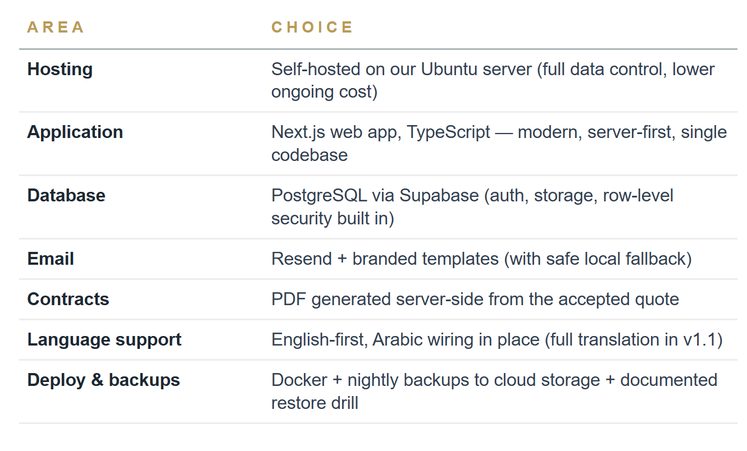
TECHNOLOGY CHOICES
Stack at a glance
The one slide with technical content — everything else is system behavior.
PRINCIPLES
Boring tech, strong invariants
Standard tools the market understands. No exotic dependencies.
Money is stored as whole halalas — no decimals, no rounding drift.
Every state change logs who did it and when.
If we ever need managed hosting, the same stack moves in a day.

Slide 8
WHAT'S NEXT
The path to pilot
Roadmap — next six weeks
Risks we're watching
Pricing, quotes, acceptance
Pricing edge cases. If the math surfaces many exceptions, we pause UI and refine the model. Budget built in.
4
Suppliers send real priced quotes; organizer accepts; slot is locked.
Supplier dry-run late in the plan may reveal usability blockers. Three Sprint 6 days are reserved for polish only.
Confirm · contract · reviews · disputes
Self-hosted operations load. Managed hosting is the fallback if ops starts eating time. Not needed so far.
5
Full loop closed: confirmation → contract PDF → reviews → disputes.
Local environment boot is the only thing blocking an in-browser end-to-end demo today.
Hardening & pilot readiness
6
Production deploy, backup drill, 2–3 friendly suppliers onboarded for real.
Half the pilot is built. Supplier side is end-to-end. Next six weeks add pricing · acceptance · contracts · reviews · deploy.

